Slide 1
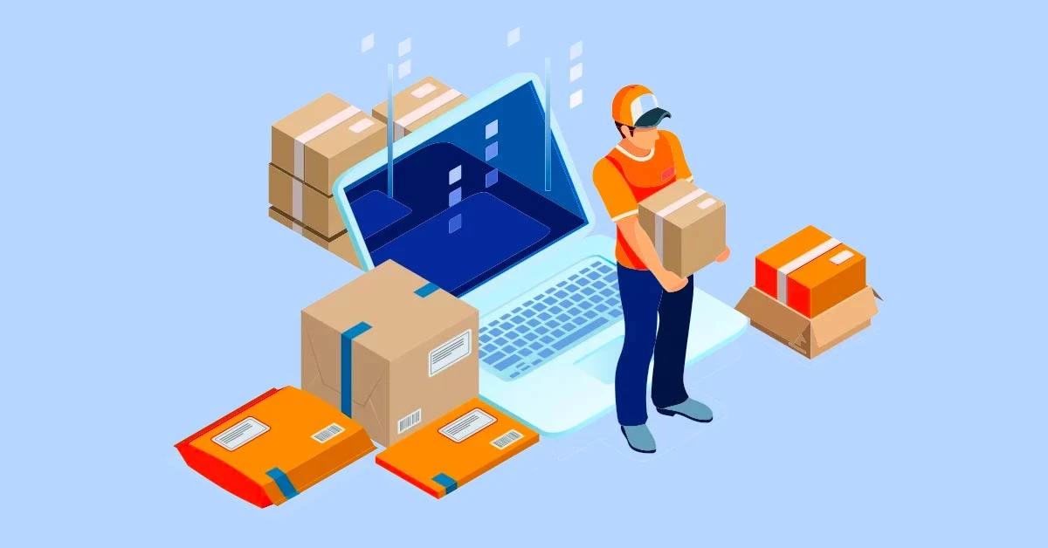
Courier Service Management System
Mirjam Nilsson

Slide 2
Courier Service Management System
Submitted to:
Submitted By:
Dr. Mohammad Rabiul Islam
Assistant Professor
Department of Computer science
Faizur Rahman 20-43701-2
Md. Sabit Hasan 20-43703-2
Md. Ashraful Islam 20-43710-2

Slide 3
Outline
Use-Case Diagram
Social Impact
Development plan
Project Schedule
Gantt Chart
Marketing Plan
Developing needs
COST and Profit Analysis
Introduction
About services
Background problem
Solution to the problem
System Features
Interface
Er Diagram
Activity Diagram

Slide 4
Introduction
"Introducing the Courier Service Management System: Streamlining Operations and Enhancing Customer Experience. This innovative solution offers automated package tracking, efficient order management, and real-time updates for both staff and customers. With user-centric design and robust security, our system optimizes courier services, boosting operational efficiency and customer satisfaction. Join us in revolutionizing the courier industry and delivering seamless experiences."

Slide 5
About Services
Package Delivery
Branch Management
Staff Management
Package Management
Realtime Tracking
User-friendly Interface
5

Slide 6
Background Problem
complex and dynamic nature of modern courier services
manual management becomes prone to errors delays, and inefficiencies.
miscommunication, missed deadlines, poor resource allocation, and dissatisfied customers
Customers today expect transparency, prompt deliveries, and reliable tracking, making it imperative for courier services to adapt and provide a seamless experience.

Slide 7
Solution to the Problem
Streamlined Courier Operations
Role-Based Access
Tracking
User-Centric Interface
Reporting

Slide 8
System Features
User login
Courier Booking
Tracking
Delivery Management
Staff Management
Branch Management

Slide 9
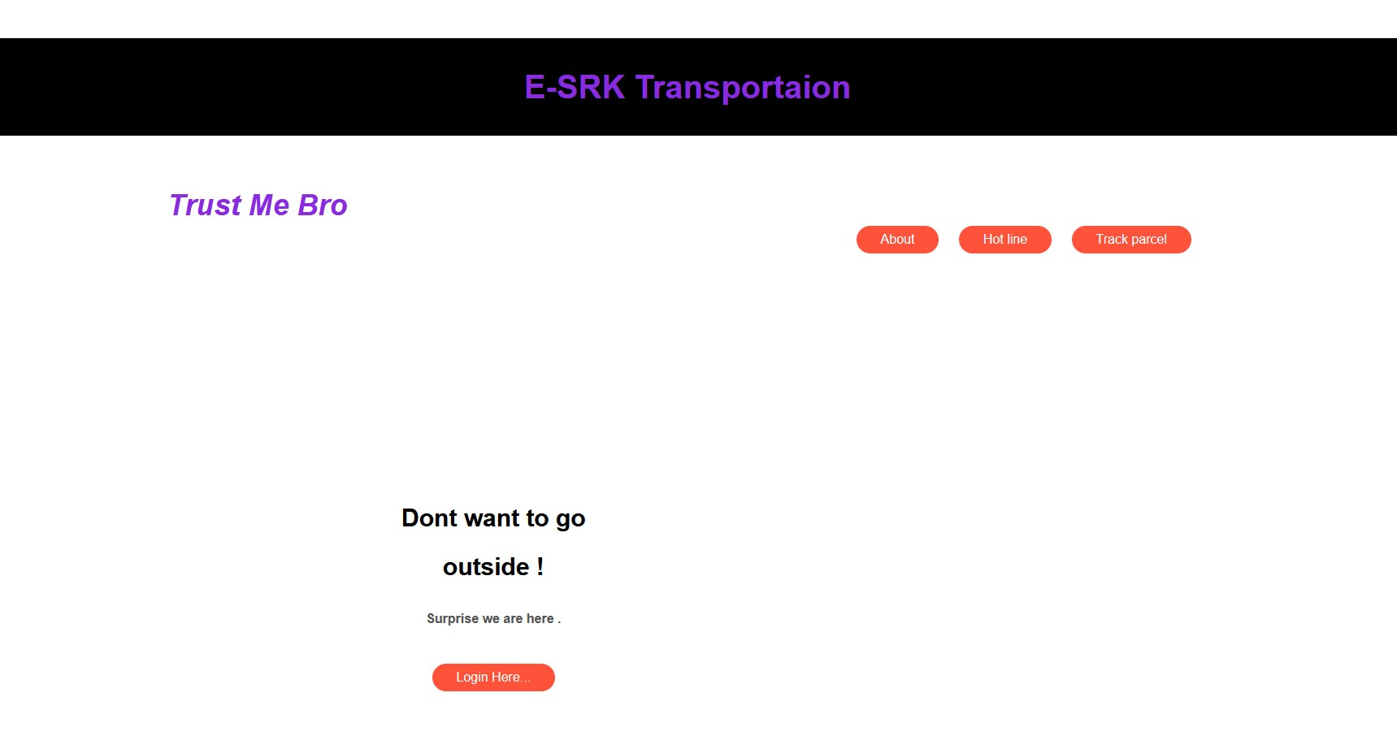
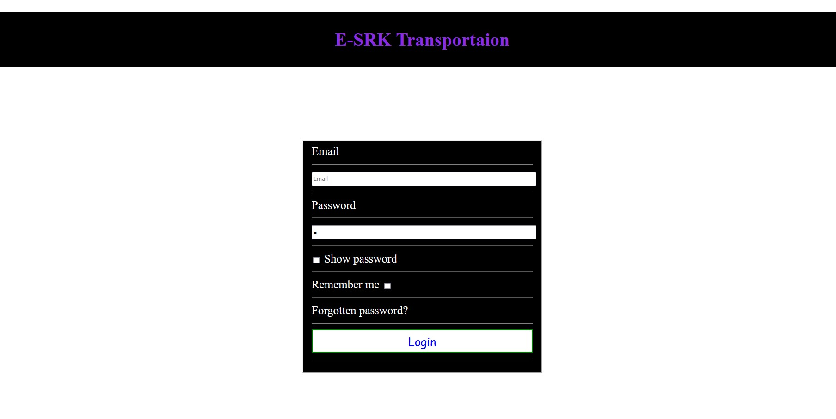
Interfaces

Slide 10
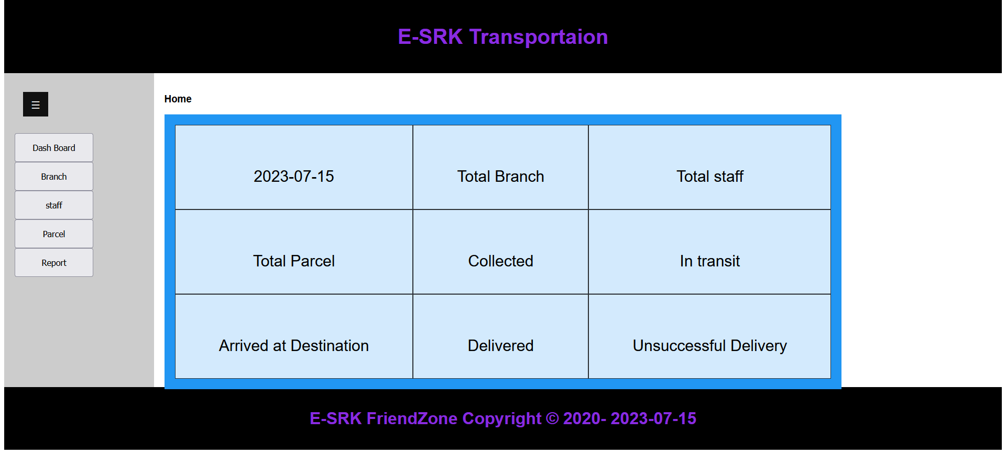

Slide 11
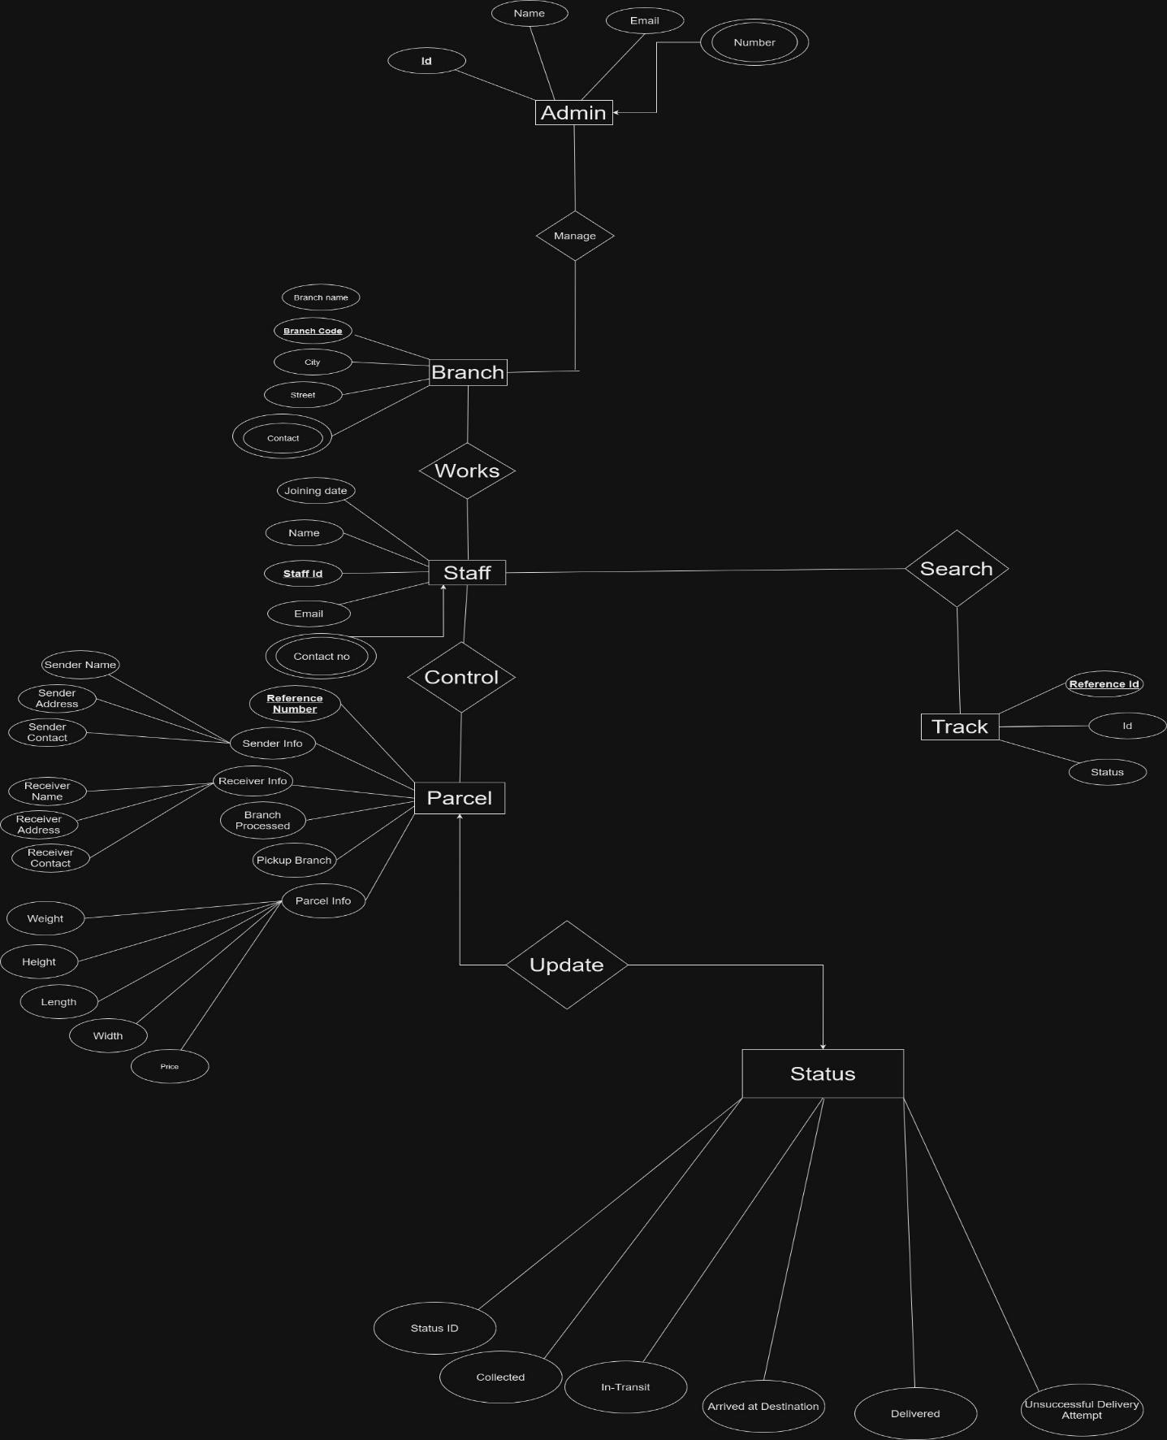
ER Diagrams

Slide 12
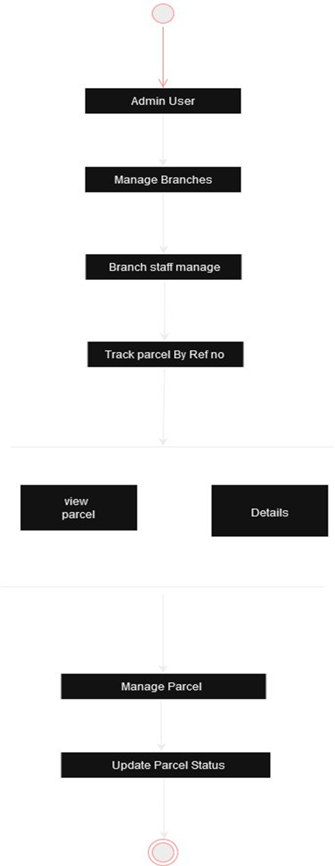
Activity Diagram

Slide 13
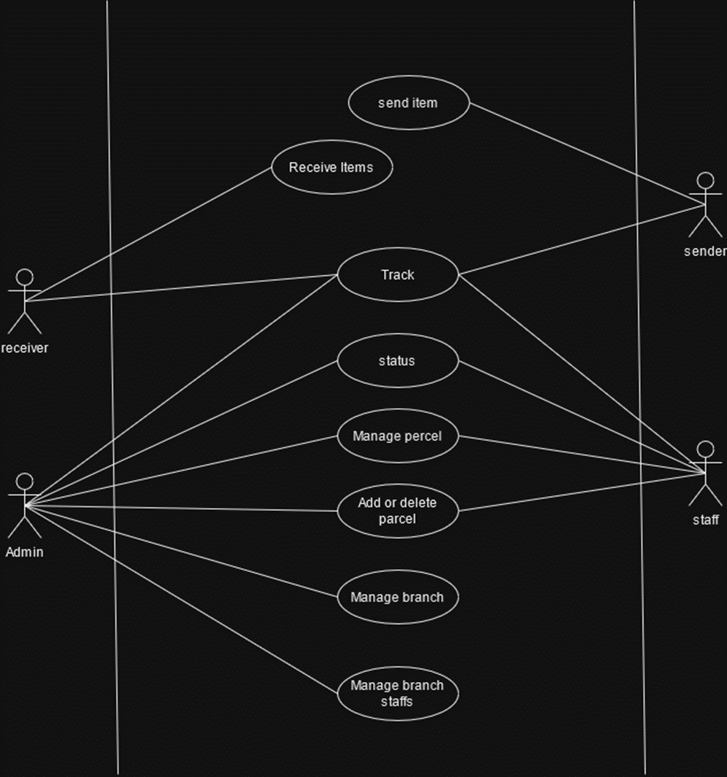
Use-case Diagram

Slide 14
Social Impact
offers a streamlined approach to managing courier operations
By automating tasks such as booking management, package tracking, and reporting, the system reduces the reliance on manual processes.
increased operational efficiency, shorter delivery times, and reduced instances of human error.
real-time tracking capabilities, both staff members and customers gain accurate visibility

Slide 15
Development Plan
Requirements Gathering and Analysis
System Design
Development
Testing
Deployment
Training and Documentation
Launch and Monitoring
Maintenance and Updates

Slide 16
Project Schedule
Planning Phase: Weeks 1-3
Requirements and feasibility Analysis Phase: Weeks 3-4
Design Phase: Weeks 4-6
Development Phase: Weeks 7-8
Testing Phase: Weeks 9
Deployment Phase: Weeks 10
Marketing Phase: Weeks 11-12
Maintenance Phase: Weeks 13-15

Slide 17
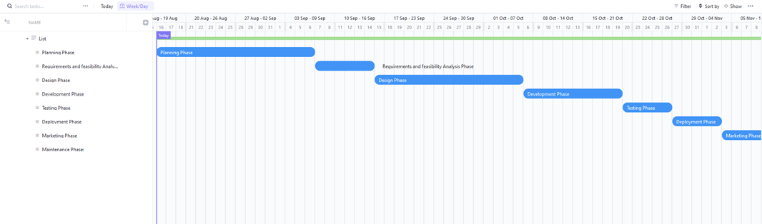
Gantt Chart

Slide 18
Marketing Plan
Short-Term Marketing Plan
Long-Term Marketing Plan
Awareness Campaign
Partnerships and Collaborations
Limited-Time Offers
Press Releases and Blog Posts
Email Campaigns
Content Marketing
Customer Testimonials
Search Engine Optimization (SEO)
Webinars and Workshops
Community Engagement
Referral Program
Continuous Updates

Slide 19
Developing Needs
System Developer
Database Administrator
Quality Assurance Engineer
UI/UX Designers
Project Manager
Efficient budget use

Slide 20
Cost Volume Profit Analysis
Cost Analysis:
Profit Analysis:
Development:20000 BDT
Design: 15000 BDT
Marketing & Advertising: 10000 BDT
Miscellaneous Expenses: 5000 BDT
Total Budget: 50000 BDT
Our Total Budget = 50000 BDT
Selling Cost = 80000 BDT
At 1 time sell profit = (80000-50000) = 30000 BDT
Expected Selling = 10
At 10 times sell profit = (30000*10) = 300000 BDT

Slide 21
Thank you

